Slide 1











From Zero to XKCD pipeline
using dbt, Airflow, GCP, and Docker
Minni Zhu
2025/02/03

Slide 2
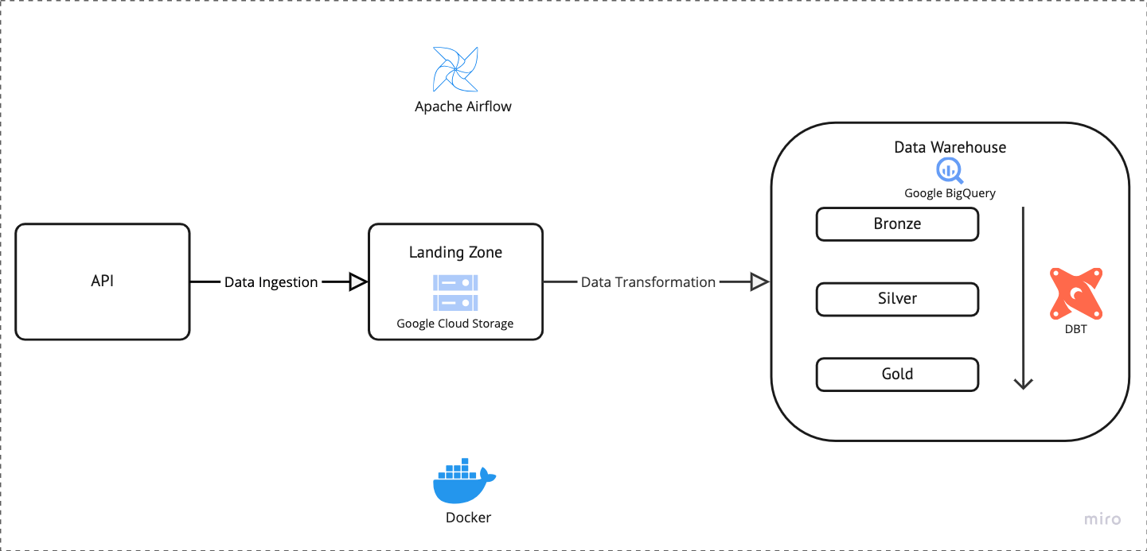
Pipeline Architechture
Notes:
After going through the case study and requirements, I came up with this general pipeline architecture. I decided to use Apache Airflow, dbt, and Google BigQuery as the core tools. Honestly, I never used these tools before. In Unilever, we use Azure data factory, databricks, and azure cloud. But when I saw the opportunity to work on this, I thought, 'Why not challenge myself?' I love learning new technologies, and this seemed like the perfect chance to dive into a stack that’s both powerful and widely used. Besides, to make my life a bit easier and to avoid the possible charge from google, I decided to run the pipeline locally using docker, instead of deploying and running it on the google cloud.
Just to briefly go through the pipeline, the data starts from the xkcd API—this is the raw data source, the raw data will be loaded and stored in a Landing Zone on Google Cloud Storage. This acts as a temporary holding area where the data is safe and ready to be processed. The raw data will be ingested into bigquery as a data warehouse, and dbt will be used in the process. I decided on the medallion warehouse structure: Bronze for the raw, unprocessed data. Silver for Cleaned, enriched, and structured data. Gold for Fully polished data, ready for analytics. Apache Airflow will be used to orchestrate the whole pipeline

Slide 3
Get Started: Data Ingestion
Notes:
I spent two days diving into courses on Udemy and YouTube about Airflow and dbt. By the end, I had a basic understanding of how they work. With that foundation, I decided it was time to stop overthinking and take action. I started with the first data ingestion step and focused on creating the initial DAG in Airflow to extract data from the API.

Slide 4
Get Started: Data Ingestion
Before coding:
https://xkcd.com/info.0.json
returns latest comic data
https://xkcd.com/{day}/info.0.json
returns a specific day’s comic data
Field | Meaning
month | The month the comic was published.
num | The comic number (unique identifier for each comic).
link | An optional link associated with the comic.
year | The year the comic was published.
news | Any news or updates related to the comic.
safe_title | A user-friendly title for the comic, meant to be more descriptive and suitable for display.
transcript | The transcript for the comic, which would include any dialogue or text.
alt | The alt text for the comic, often containing humor or additional context.
img | The URL of the comic image.
title | The title of the comic (typically the same as the safe_title).
day | The day the comic was published.
Notes:
"Before diving into the coding, I took some time to thoroughly review the API to understand how it works and what data it provides. The API offers two main endpoints:
The current comic endpoint provides data for the latest comic available.
The specific comic endpoint allows you to fetch data for a specific comic by passing the comic number (e.g., https://xkcd.com/1000/info.0.json for comic number 1000). Each comic response contains several useful fields. field num represents the comic number, which helps identify the latest comic and provides the range for historical comics. it should be a unique identifier for each comic

Slide 5
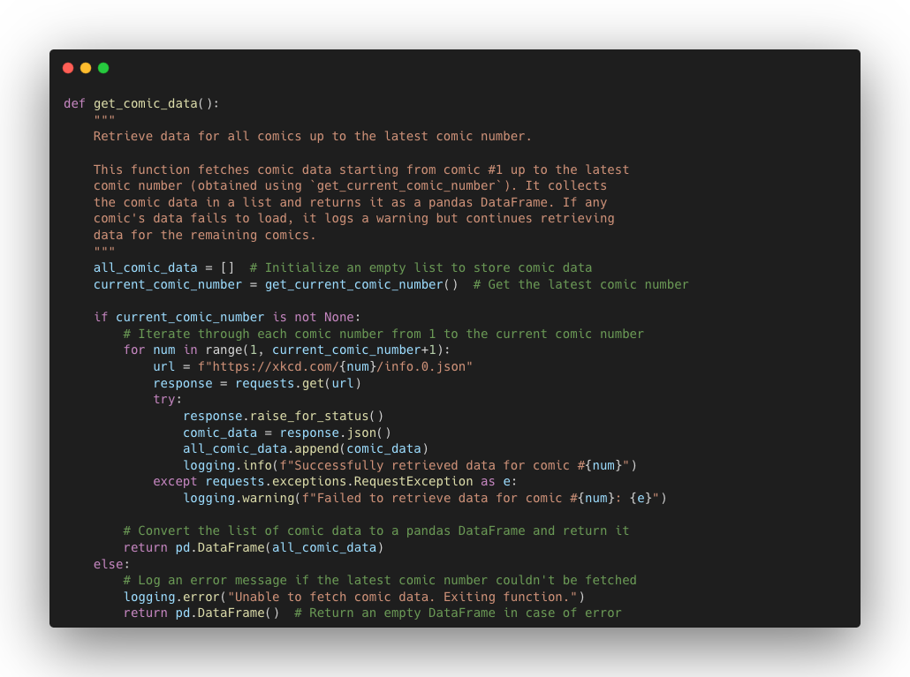
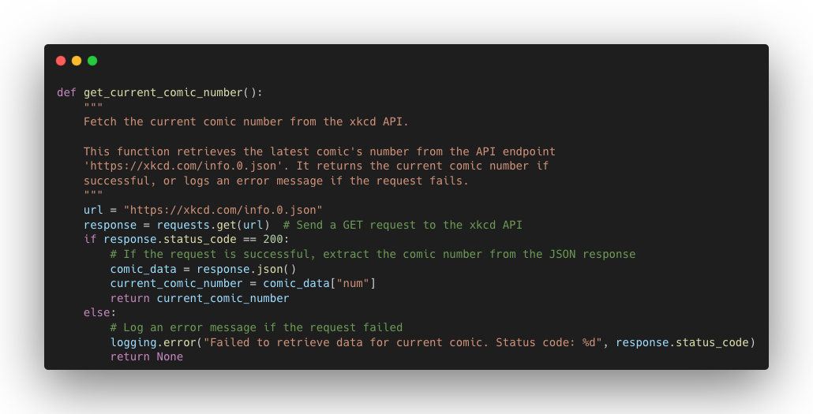
Data Ingestion 1.0 DAG– Step 1: Functions to extract comic data
get all comic data
get latest comic number
Notes:
I defined two functions. First, I need to find out the latest comic number. To do this, I called the info.0.json endpoint. after getting the latest comic number, I created a loop to collect all available comic data from the xkcd api and returned a pandas dataframe. also I added all logging information to log the progress and any issues

Slide 6
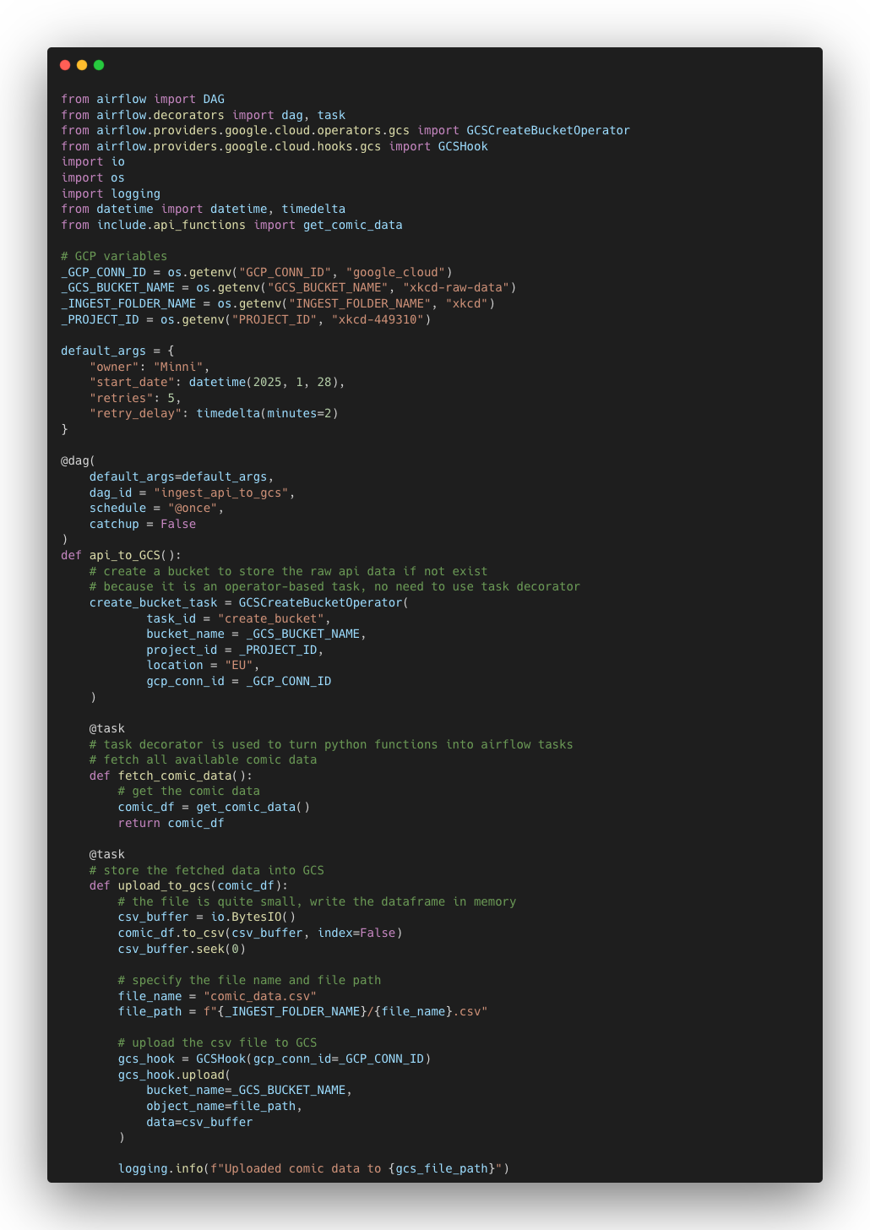
Data Ingestion 1.0 DAG – Step 2: DAG for data ingestion
Notes:
"Okay, so after setting up the API functions, I jumped into Airflow and created my first DAG.
For this first DAG, I set up three tasks:
Create a GCS bucket – I used the GCS operator to automatically create a new bucket. That’s where I’ll be storing all the comic data.
Fetch the comic data – I called my API functions here to pull in all the comic data from XKCD. It loops through all the comics and pulls in the details.
Upload the data to GCS as CSVs – Once the data’s fetched, I uploaded it as CSV files to GCS, so it’s all stored in an easy-to-use format for the next steps.

Slide 7
Data Ingestion 1.0 – Takeaways
Helps simplify defining tasks in a DAG
Task
Decorator
Operators and Hooks
DAG structure
Airflow UI
Used to interact with various services
A huge help for debugging,
tracking task progress,
and visualizing workflows
Notes:
Looking back now, my first dag seems pretty simple, but I was honestly really excited when I first saw it all come together. It was such a great feeling to see the task statuses turn green in the Airflow UI and to see that the files were really successfully uploaded to the GCS bucket. In this very first step, I also learned a lot: Task decorators: They really simplify how you define tasks. You don’t need to write as much boilerplate code to set them up. Operators and hooks: These are super useful for interacting with services like GCS or APIs. They make the whole process a lot cleaner. Constructing a simple DAG: Once I understood the basic structure, it was easy to string together tasks in a logical flow. I just make sure each task depends on the one before it. Airflow UI: I’ve spent a lot of time using the UI. It’s a lifesaver for debugging. I can check logs to figure out where something went wrong, see the progress of tasks in the graph, and check the status of every task to see if it succeeded or failed.

Slide 8

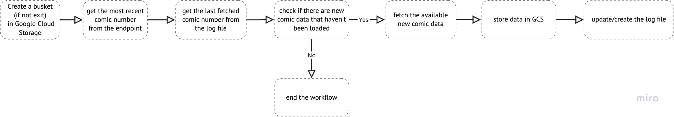
Data Ingestion 2.0 – Improving Efficiency with Incremental Load
full refresh
incremental load
Notes:
After the tryout with the first DAG, I realized the approach I was using was a bit too simple for what I wanted to achieve.
Instead of pulling all the historical comic data every time, I decided to switch to an incremental load approach.
The idea is simple: I’m assuming the owner won’t change the past comic data, so I’ll only need to extract the new comics. This means:
The API functions will now only fetch the new comic data that hasn't been pulled yet, rather than pulling everything from the start.
Every time the pipeline runs, it will only load the new data into the Google Cloud Storage bucket. This keeps things efficient and prevents redundant uploads. To implement the incremental load, I needed a way to detect the new comic data. It can be done compare the current comic number from the API with the latest comic number I’ve already stored.
So, I created a simple file in Google Cloud Storage that holds the latest comic number. Every time the pipeline runs, I:
Pull the current comic number from the API.
Compare it with the stored latest comic number.
If the current comic number is higher, it means there’s new comic data available, and I’ll fetch only the new comics starting from the stored number up to the current number.
with this thought, I redesigned the dag and the api functions. the dag tasks are listed in this workflow.

Slide 9
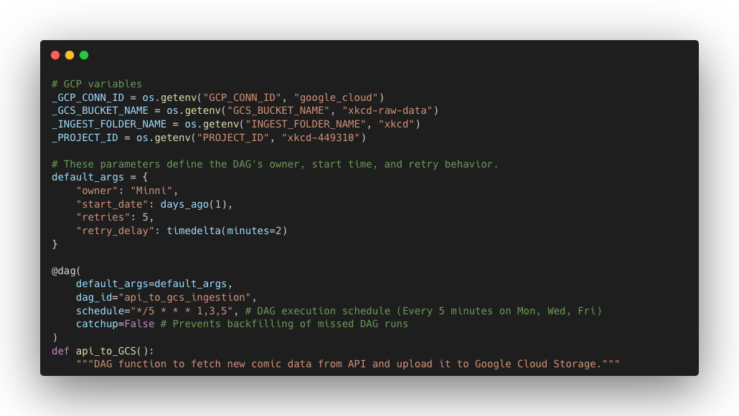
Data Ingestion 2.0 DAG – Define variables and dag configuration

Slide 10
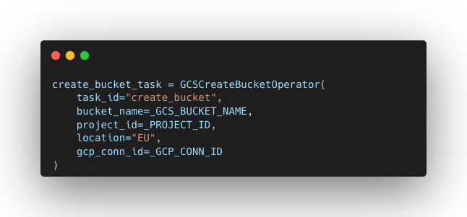
Data Ingestion 2.0 DAG – Create a bucket in GCS

Slide 11
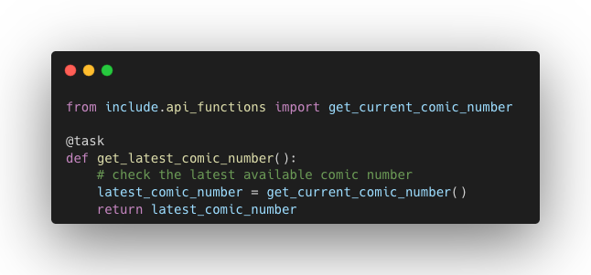
Data Ingestion 2.0 DAG – Get the most recent comic number

Slide 12
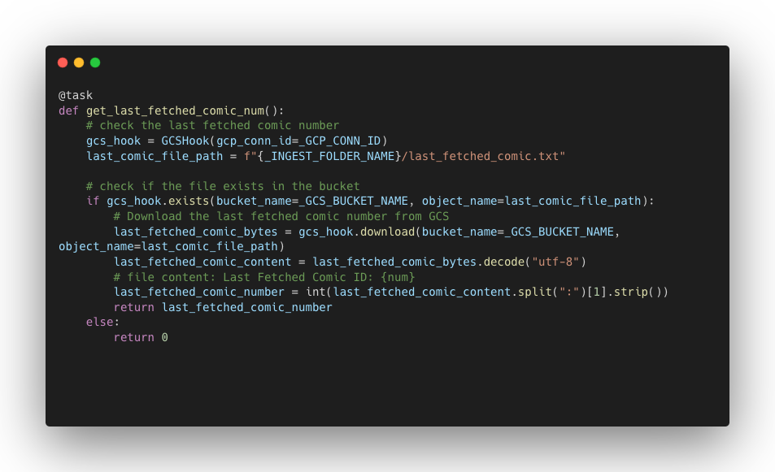
Data Ingestion 2.0 DAG – Get the last fetched comic number from the log file

Slide 13
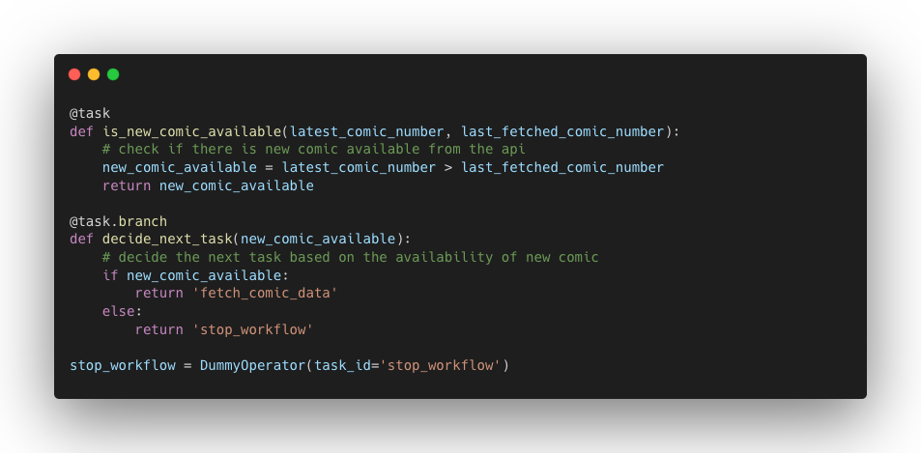
Data Ingestion 2.0 DAG – Check if there is new comic data

Slide 14
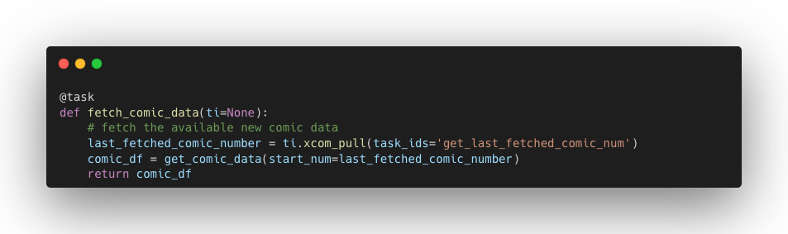
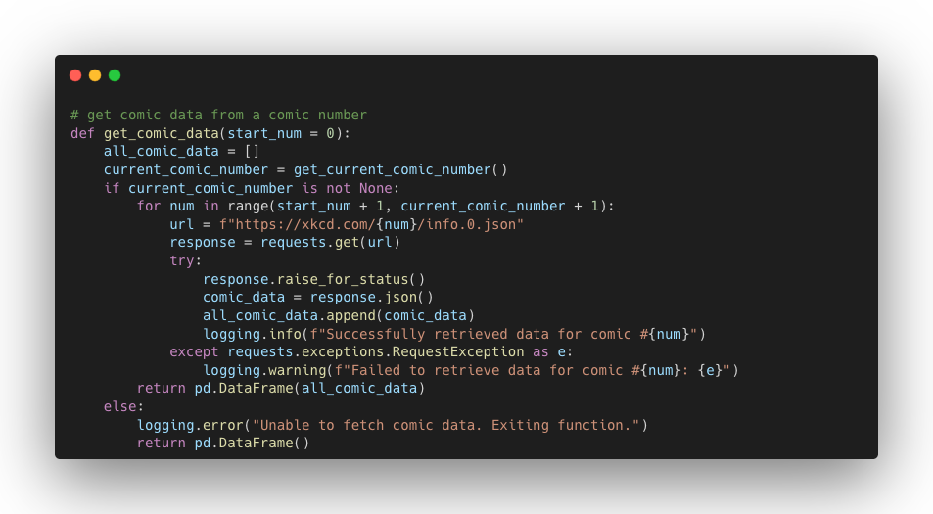
Data Ingestion 2.0 DAG – Fetch the new available comic data

Slide 15
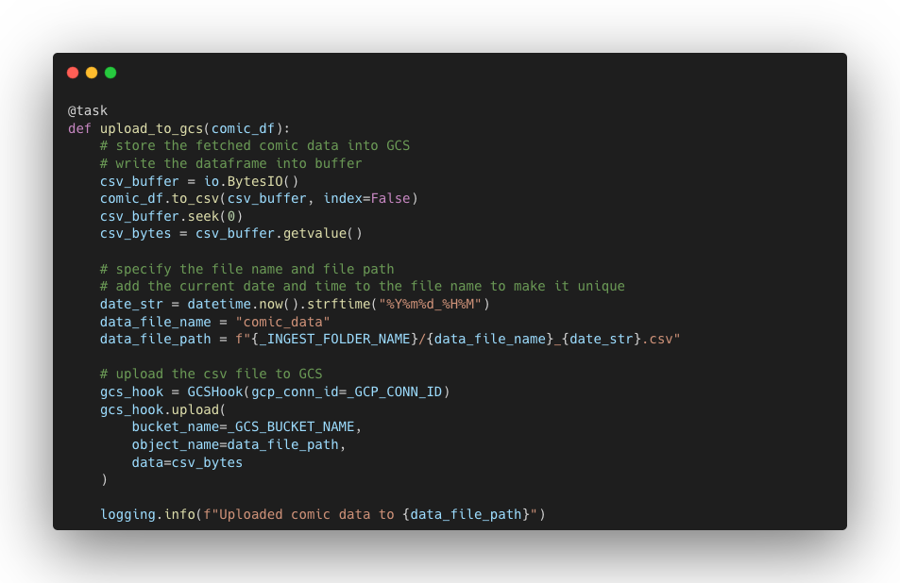
Data Ingestion 2.0 DAG – Store the new data in GCS

Slide 16
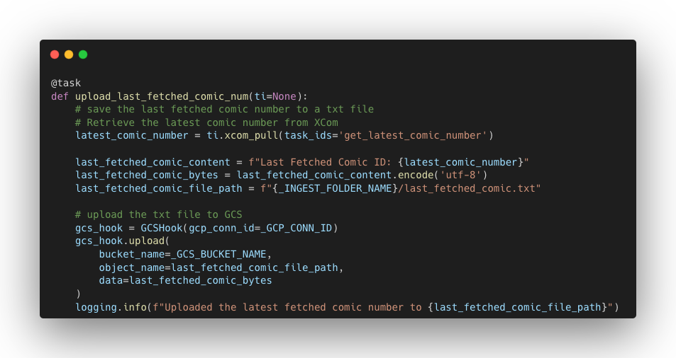
Data Ingestion 2.0 DAG – Update or create the log file to store the last fetched comic number

Slide 17
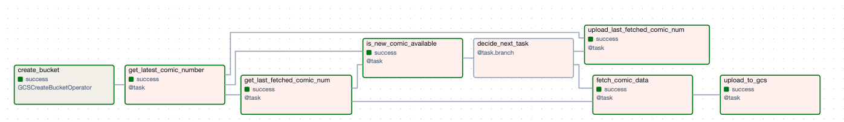
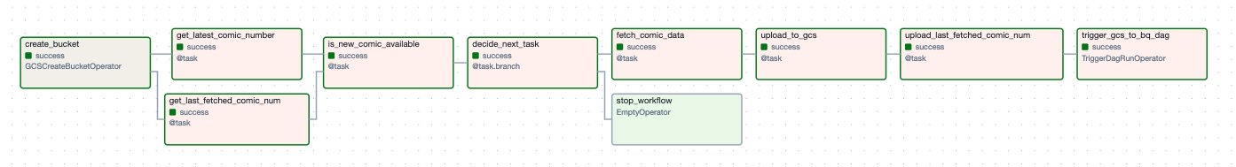
Data Ingestion 2.0 – Challenges and Takeaways
Error
Handeling
DAG graph
Xcom
Task Branching
decide which tasks to run based on certain conditions
pass data between tasks without having to store it outside the pipeline
Notes:
Looking back, some of the challenges I faced were actually pretty simple to solve, but at the time, they felt a bit more complicated. For example, when I first thought about structuring the pipeline, I considered dividing the process into two separate DAGs: one for the initial load and another for the incremental load. At first, it seemed like a good idea, but now, I realize it was unnecessary. It’s much simpler to handle it all in one DAG, and that structure makes more sense now.
Another challenge I ran into was the Airflow UI flow. When I first looked at the UI, I noticed that other people's DAGs had arrows showing the flow, while mine didn’t. It was a bit confusing because I wasn’t sure if my tasks were set up correctly. Also there were many relationships in the graph even though I didn’t set up the dependencies between tasks. but once I started using XComs the dag graph became a lot clearer. I could see how the tasks communicate with each other, and the flow in the UI finally made sense.

Slide 18
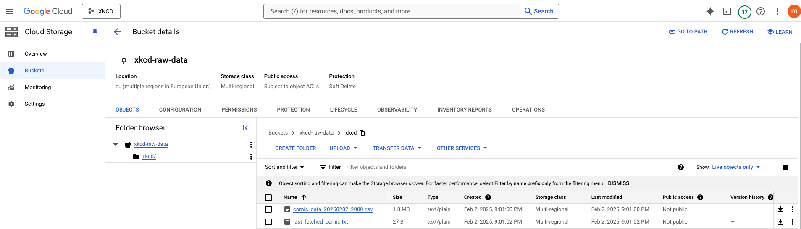
Data Ingestion 2.0 – Check data in GCS

Slide 19
Move on – Data transformation
Notes:
Once the ingestion DAG was running smoothly and the data was being loaded into GCS, I moved on to the next phase—transformation. But before jumping into DBT, I needed to make sure the data was in BigQuery, since that’s where the transformation would take place. So, I had to create a process to move the files from the landing zone in GCS to BigQuery first

Slide 20
Data transformation – step 1: GCS (landing zone) to Bigquery (data warehouse)
Notes:
To make sure things ran smoothly, I created another log file to track which files had already been processed. This helps prevent re-processing the same files every time the pipeline runs. By keeping track of the files that have already been moved to BigQuery, I can ensure that the pipeline only processes new files and doesn’t repeat work. The tasks in this dag are listed here.

Slide 21
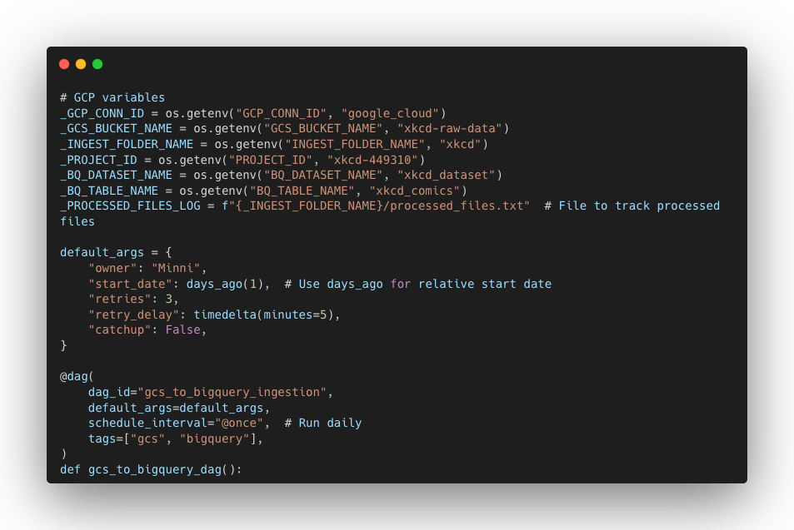
Data transformation DAG – Define variables and dag configuration

Slide 22
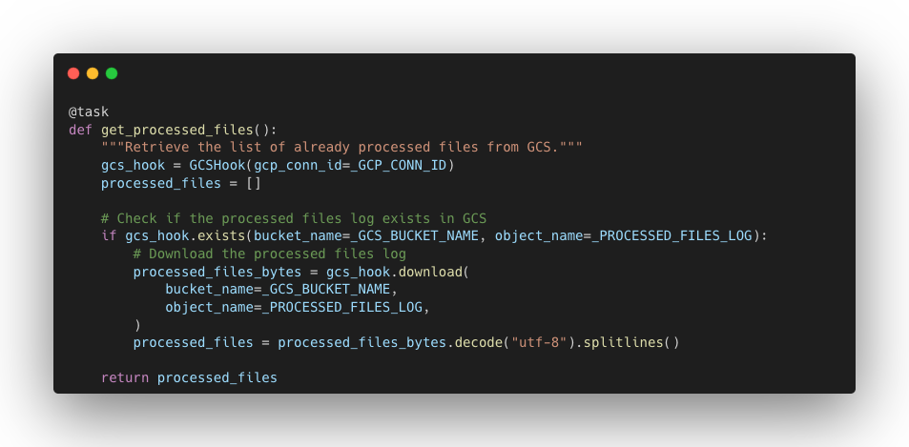
Data transformation DAG – Get already processed file list

Slide 23
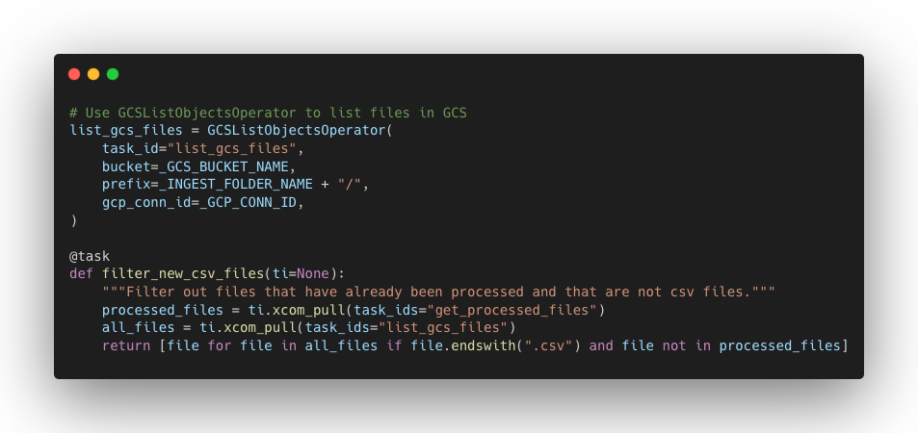
Data transformation DAG – Filter files that haven’t been processed

Slide 24
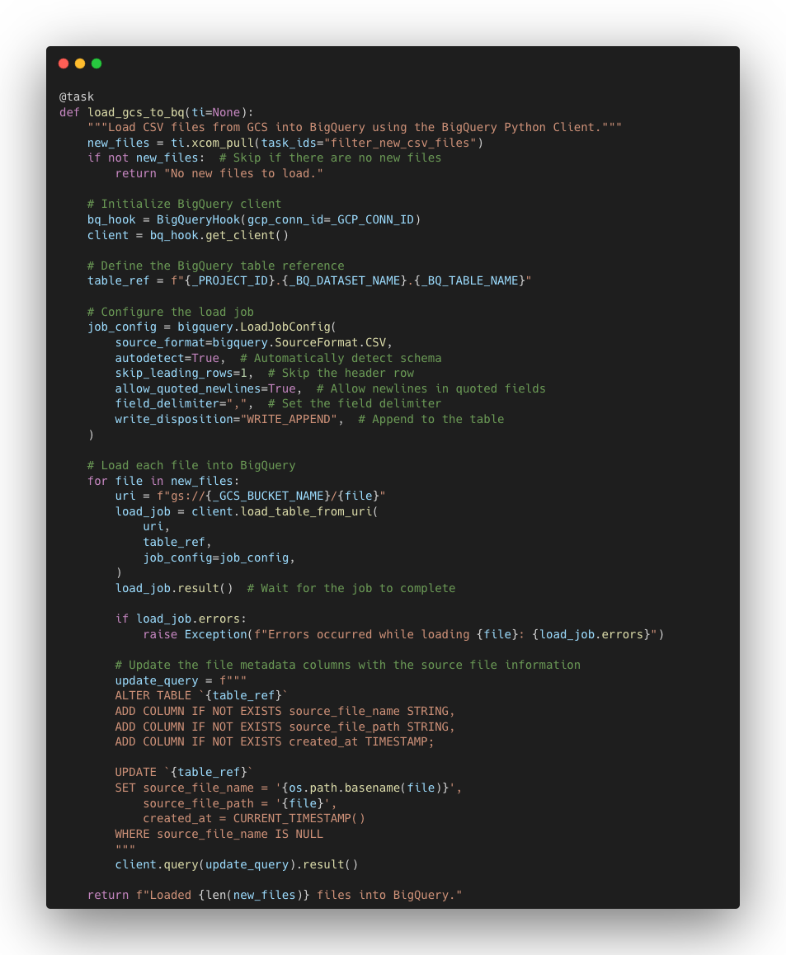
Data transformation DAG – Load the new comic data to Bigquery

Slide 25
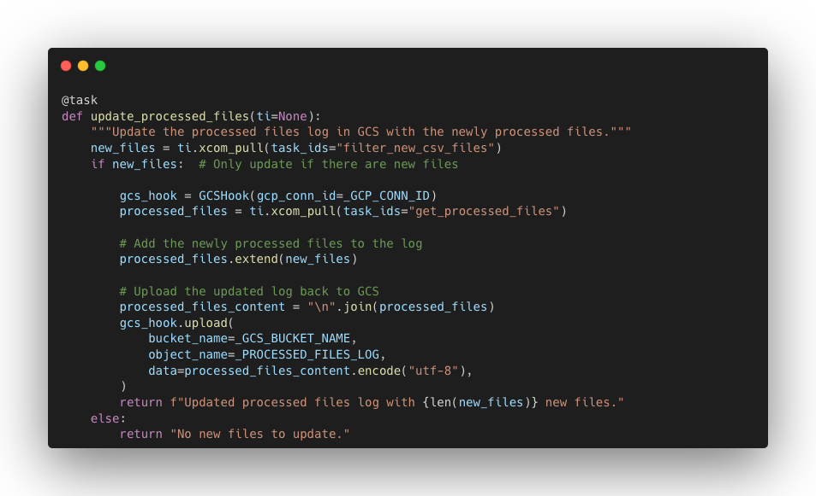
Data transformation DAG – Update the log file

Slide 26
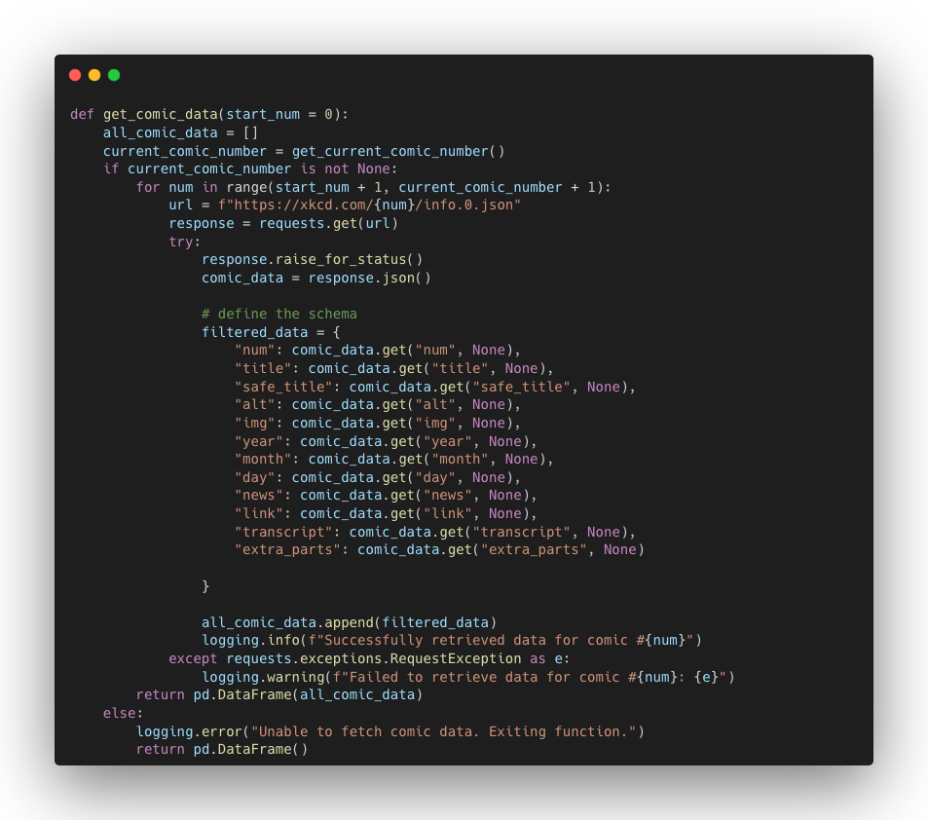
Data transformation – Oops, ERROR!!
Notes:
When I tried loading the data from GCS to BigQuery, I ran into an issue with schema mismatch. The error occurred because there was a column called extra_part that wasn’t consistently included in the API response—sometimes it was there, and other times it wasn’t. This caused BigQuery to reject the data when it detected the inconsistency.
I tried several methods within the DAG to match the schema, but no matter what I did, I couldn’t make it work. After a bit of trial and error, I realized the most straightforward solution was to restrict the schema in the API extraction script itself. I made sure that the API would always return the same set of columns, and this solved the schema mismatch issue.

Slide 27
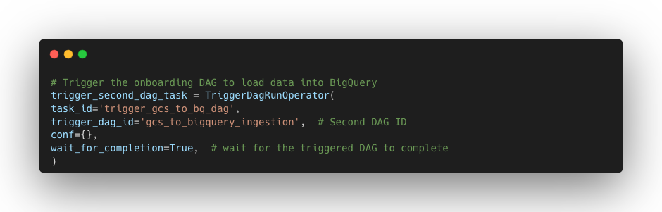

Slide 28
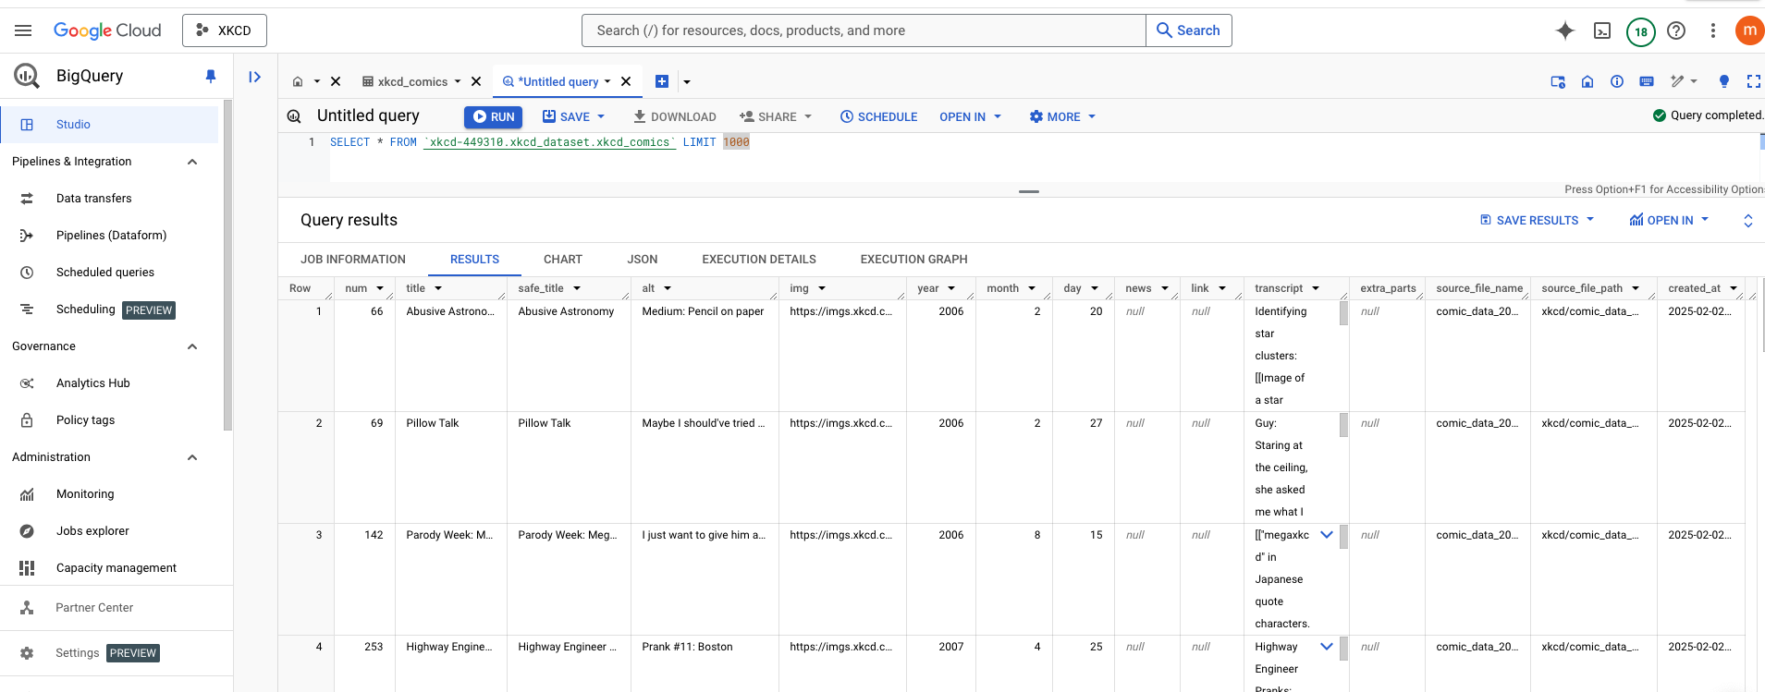
Data transformation – Check the raw table in Bigquery

Slide 29
Data transformation – Challenge and Takeaway
figuring out the correct operator or method
official documentation
Notes:
One of the challenges I faced was figuring out the correct operator or method to load files from GCS to BigQuery. At first, I was testing different approaches without giving the official documentation enough attention, but I quickly realized how important it really is. The documentation helped me understand the right way to use the operators and avoid unnecessary mistakes.
Once I went back and focused on the official docs, everything became much clearer. It saved me time and made the whole process a lot smoother. Lesson learned—always check the docs first!"

Slide 30
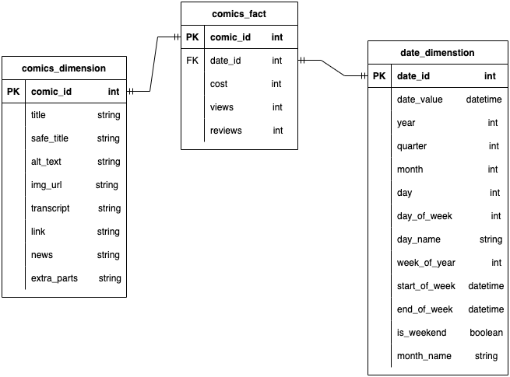
Data transformation – Step 2: Get started with DBT – date model
Notes:
After the raw table was created in BigQuery, I moved on to the next step: starting with DBT. DBT is what I’ll use to transform the data into a format suitable for analysis. First I decided on the data model. I used a star schema to model the data

Slide 31
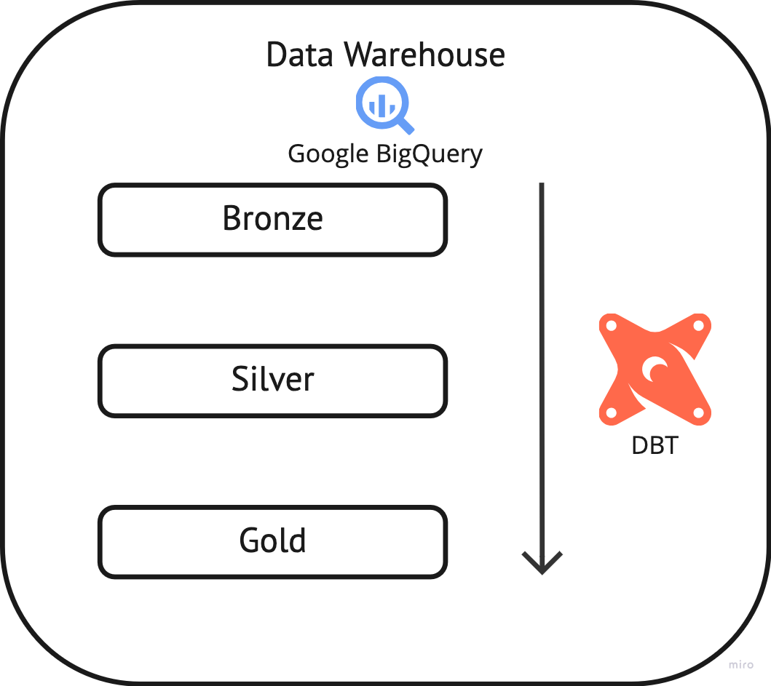
Data transformation – Step 2: Get started with DBT – Medallion structure
Bronze Layer:
Raw, unprocessed data
Changed column names and added basic logging information
An incremental table with comic_id
Silver Layer:
Comic Dimension table: Selects all descriptive columns from the bronze comic data; an incremental table
Comic Fact table: Calculates metrics (cost, views, reviews) and joins with the date dimension table to get the date_id; an incremental table
Gold Layer:
One incremental table with all extended date information from 2006 to the current day
In each layer, an extra timestamp is added
Notes:
After designing the star schema, I started building the models layer by layer.
Bronze Layer: This is where I keep the raw, unprocessed data. In this layer, I renamed some columns and added basic logging information. The data is incremental here, with each comic having a unique comic_id.
Silver Layer: Here, I created the comic dimension and comic fact tables. For the dimension table, I selected all the descriptive columns from the bronze layer’s comic data. The fact table, on the other hand, calculates key metrics like cost, views, and reviews according to the requirements. I also joined this with the date dimension table to get a more structured view of the data.
Gold Layer: In this layer, I created an incremental table with all extended date information from 2006 to the current day. The aggregated fact tables are materialized as views for quicker analysis and better performance. Each of these layers is designed as an incremental table to ensure that only new or changed data is processed, rather than reloading the entire dataset every time. This approach helps improve efficiency and saves processing time, especially as the dataset grows. In each of these layers, I’ve also added an extra timestamp to track when the data was loaded, ensuring that I can keep track of when new data arrives and when it was processed

Slide 32
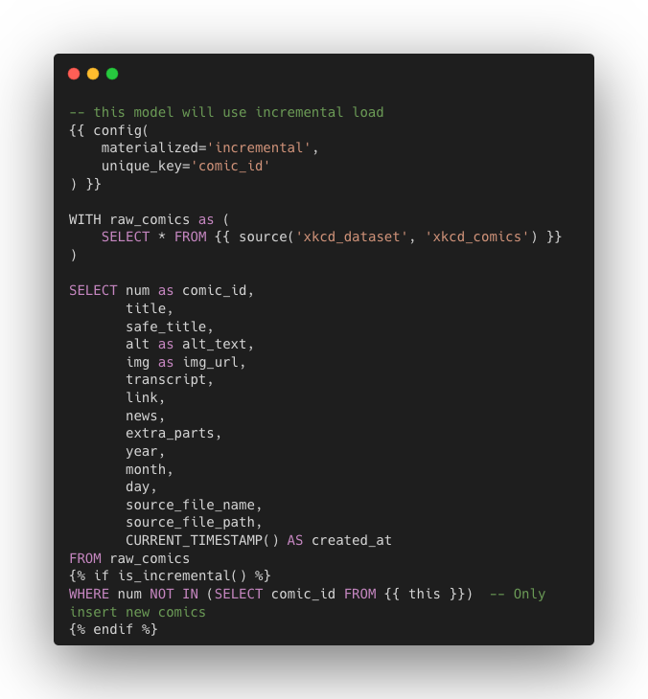
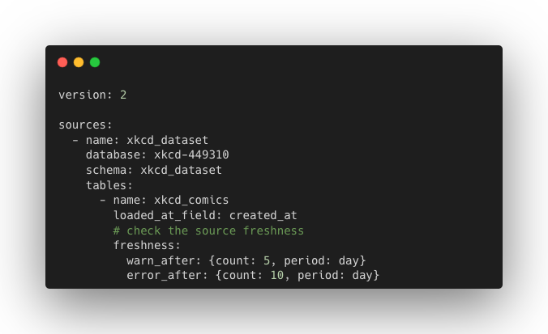
Data transformation – Bronze
Notes:
In the bronze layer, I added a freshness check for the xkcd_comics table. This helps ensure that the data is up-to-date. I used the created_at field to track when the data was last loaded.
The freshness check is set up as :
If the data is older than 5 days, it will issue a warning.
If the data is older than 10 days, it will trigger an error.

Slide 33
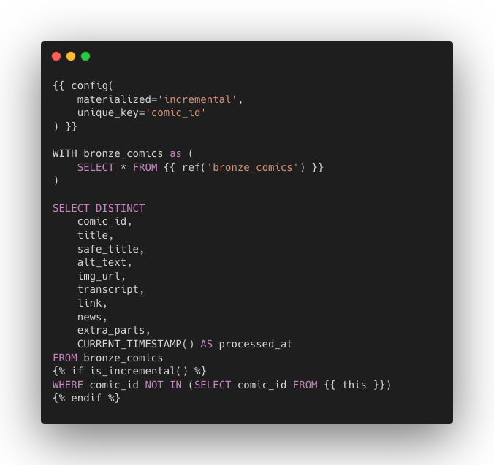
Data transformation – Silver comic dimension

Slide 34
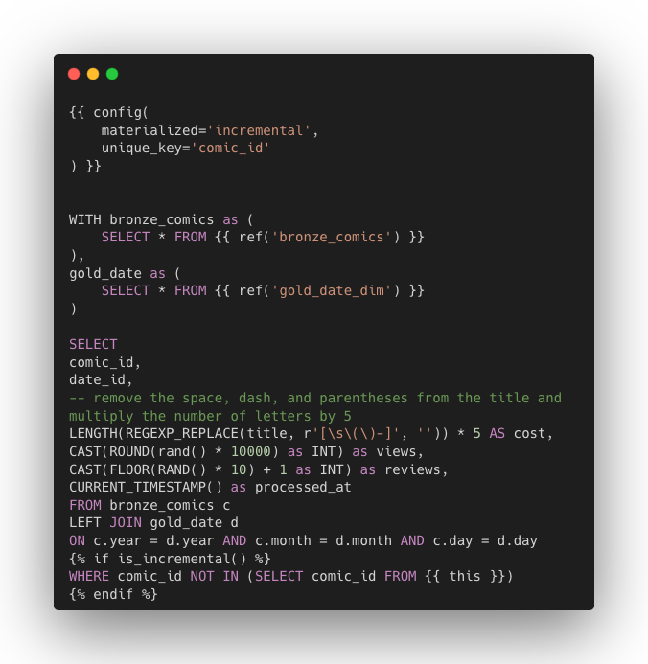
Data transformation – Silver comic fact

Slide 35
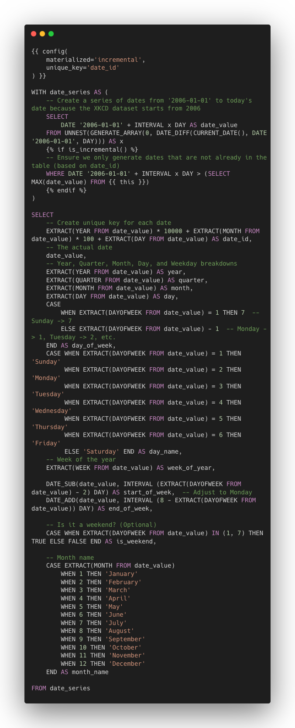
Data transformation – Gold date dimension

Slide 36
Data transformation – Data quality – built-in tests
Model Name | Column Name | Test Type
bronze_comics | comic_id | unique
 |  | not_null
silver_comics_fct | comic_id | unique
 |  | not_null
 | date_id | not_null
 | cost | not_null
 | views | not_null
 | reviews | not_null
silver_comics_dim | comic_id | unique
 |  | not_null
silver_date_dim | date_id | unique
 |  | not_null
Notes:
To ensure data quality, I added some built-in generic tests to my DBT models in the schema yaml file . These tests check for uniqueness and null values, which are key to maintaining data integrity across the pipeline.
In the bronze_comics table, I tested:
comic_id: Ensured it’s both unique and not_null.
In the silver_comics_fct table, I tested:
comic_id: Ensured it’s unique and not_null.
date_id: Ensured it’s not_null.
cost, views, reviews: Ensured these columns are all not_null.
In the silver_comics_dim table, I tested:
comic_id: Ensured it’s unique and not_null.
In the silver_date_dim table, I tested:
date_id: Ensured it’s unique and not_null.

Slide 37
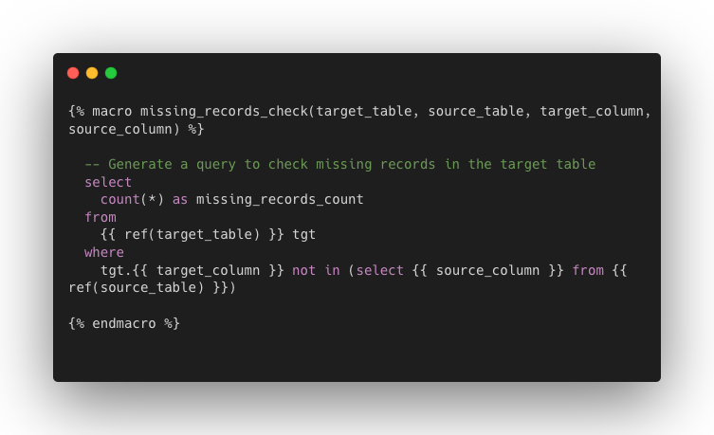
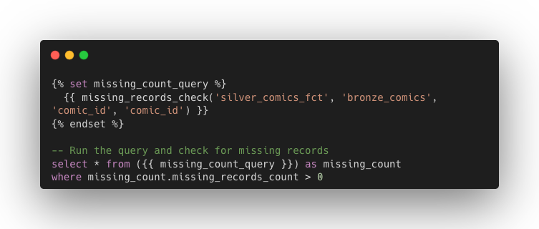
Data transformation – Data quality – customed test
Notes:
To further improve data quality checks, I used DBT macros to define a custom test for missing records between two tables.
The macro, called missing_records_check, is designed to compare records between a target table and a source table. Specifically, it checks whether there are any records in the target table that are missing in the source table based on a common column.
For example, I applied this macro to check for missing comic_id records in the silver_comics_fct table compared to the bronze_comics table. The query returns the count of missing records, and if any are found, the test fails. This custom test ensures that the data is consistent between the different layers of the pipeline.

Slide 38
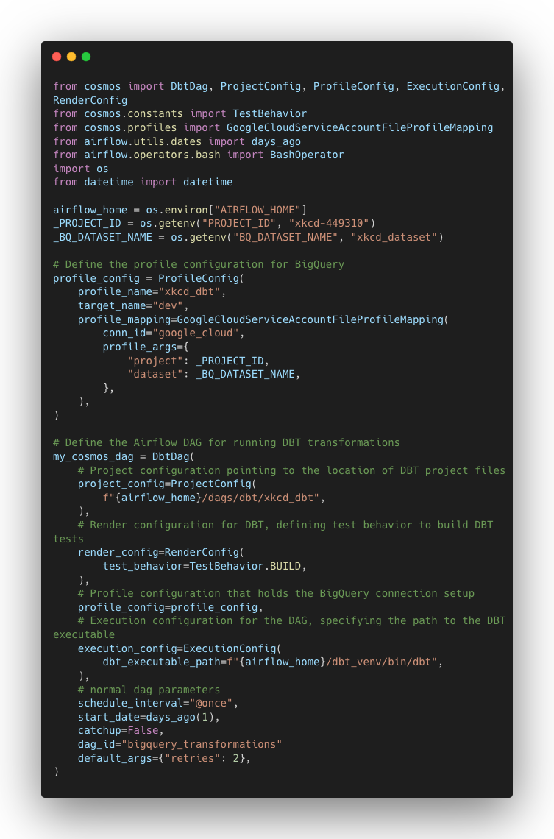
Data transformation DAG – Integrate DBT into Airflow using cosmos

Slide 39
Data transformation – Challenges and Takeaway
macro
dbt project structure
data quality
Notes:
DBT wasn't as challenging for me as Airflow, because I was already familiar with SQL. However, I still learned a lot during this project, including the basic structure of DBT models, how to use macros for reusable code, and the importance of data quality and testing—which I had never really focused on before.
It's been a great opportunity to not just solidify what I knew but to really dive into things like testing and ensuring that the data remains clean and accurate throughout the pipeline."

Slide 40
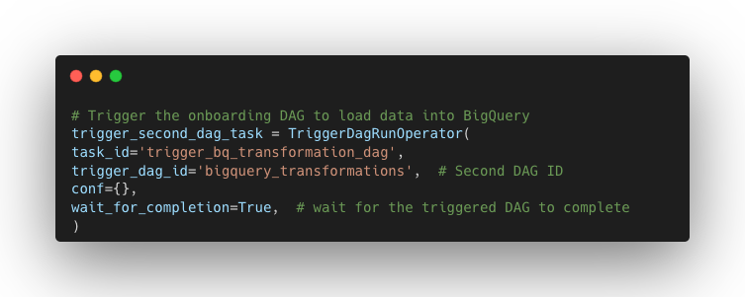
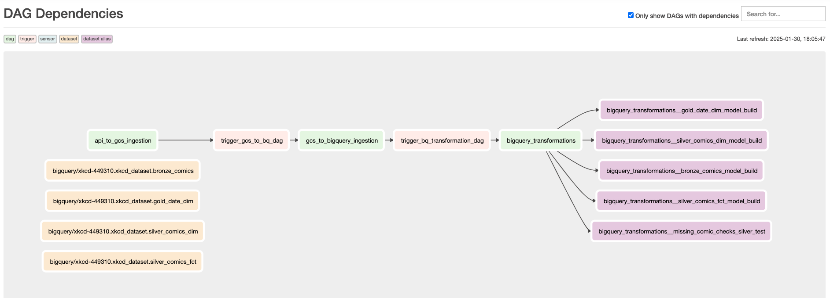
Putting it all together
Notes:
"Finally, when it came to orchestrating the workflow, I set up the dependencies among the three DAGs to ensure a smooth, automated process:
Ingestion DAG: The first DAG is responsible for extracting the data from the API and uploading it to Google Cloud Storage (GCS). It must run first because the raw data needs to be available for the next steps.
Transformation DAG: Once the ingestion DAG successfully finishes, this DAG kicks in. It moves the files from the landing zone to BigQuery and starts transforming the data for analysis.
DBT DAG: The third DAG handles the execution of DBT models. It relies on the previous DAGs to have loaded the data into BigQuery, so that DBT can perform the transformations and ensure everything is structured and clean for downstream analysis.
By linking the DAGs together, I made sure each step in the pipeline only starts once the previous one completes, creating a clear flow of data from extraction to transformation to final modeling."

Slide 41
What can I do better?
Error Handling Logic and Logging
Avoid Simultaneous Task Execution
Airflow Variables
Integrate Spark in DBT and Airflow
Add More Tests (eg. Accepted Values)
Send Notifications

Slide 42
What should I do to bring it to the productionised setting?
Security
CI/CD
Monitoring and Alerting
Integrate Spark in DBT and Airflow
Add More Tests (eg. Accepted Values)

Slide 43
THANK YOU! Q&A

